Slide 1
Middle Ages
Medieval Times/Dark Ages

Slide 2
Why the Dark Ages?
Imples that on either end of the period, there was light.
Civilization, as previously experienced during The Roman Empire, was suspended from 500- 1500 C.E.

Slide 3
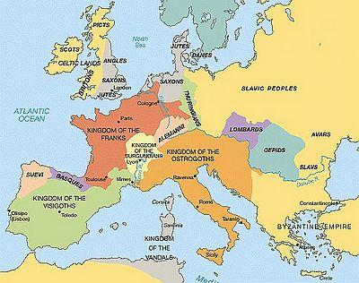
The Early Middle Ages
500-1000 C.E.
Most kingdoms were made up of inhabitants that were Pastoral Nomads or Subsistence Farmers.
Very few people could read or write.
Limited trade.
Political Leaders were Tribal Chieftains.

Slide 4
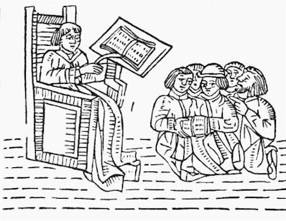
Early Middle Ages
Christianity/Roman Catholicism centralized in Rome.
Cultural Unification despite absence of centralized European authority.
Roman Concept of rule by law replaced by family ties and personal loyalties.
Warriors bound to a chief by oaths of loyalty

Slide 5
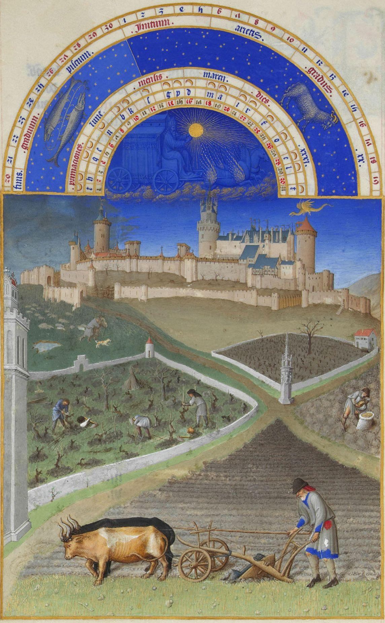
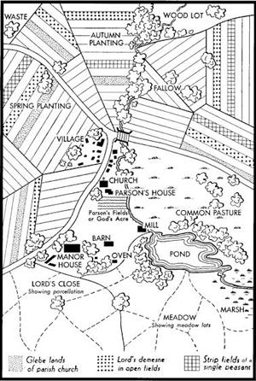
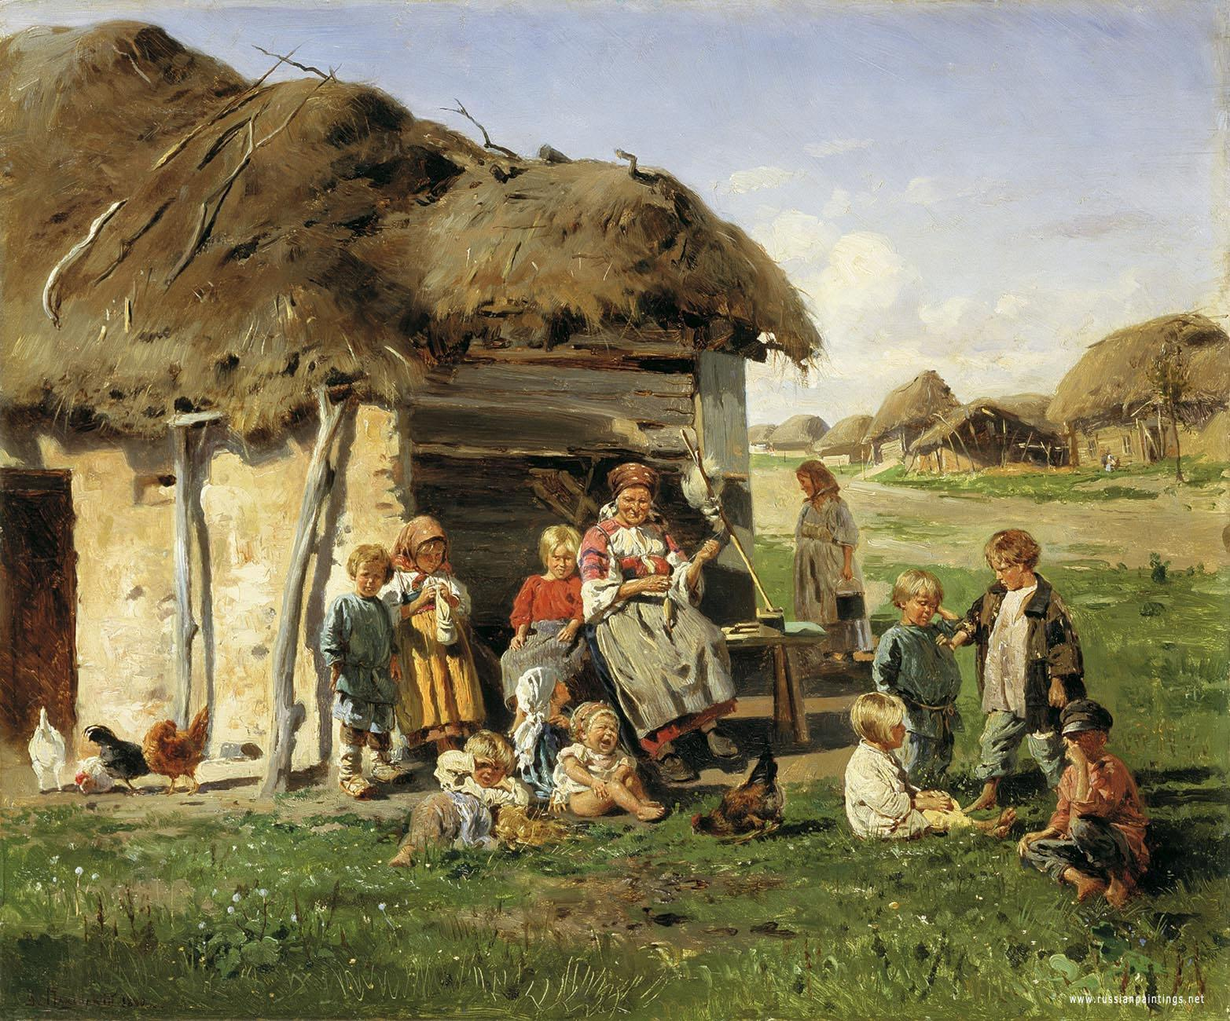
Feudalism and Manorialism
Feudalism: A complex system of political and military loyalties linked lords together.
Manorialism: a system that in which peasants were tied to land to supply labor.

Slide 6
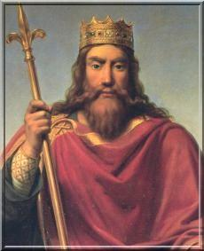
Franks
Clovis- Unified the western portion of Europe under his authority as King from 481-511 CE
Converted to Christianity.
Overtook Germanic peoples by military conquest.
Lost power to Charles the Hammer of the Carolingian Family - later to be headed by Charlemagne.

Slide 7
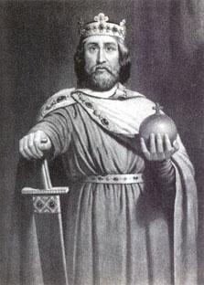
Charlemagne
Kept control of kingdom otherwise vulnerable to Viking attacks from late 700-1000 CE
Divided territory into counties headed by a count.
Charlemagne checked their power by having a royal agent acting as his “eyes and ears.”
In 800, crowned as emperor (Holy Roman Empire)
His son, heir to the throne, Louis The Pious, divided his kingdom amongst his sons who fought amongst themselves for power and supremacy.

Slide 8
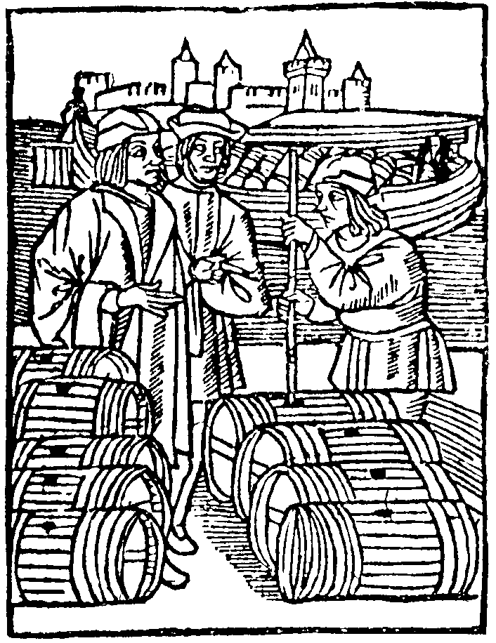
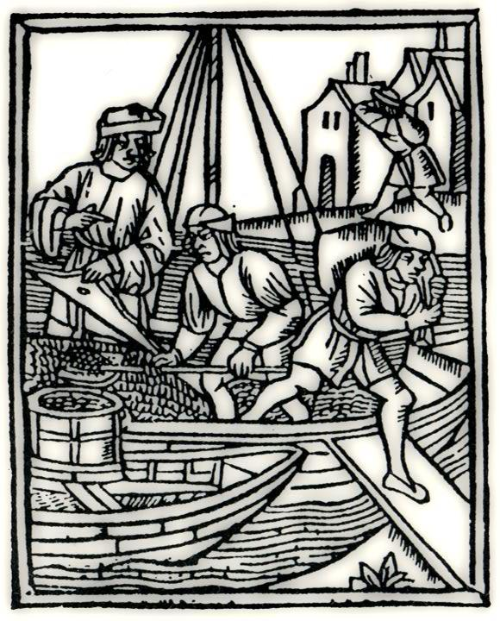
Economy of Early Middle Ages
Barter System: Trade existed in the absence of coinage or money, traded item for item.
Trade outside of the kingdom very limited, dangerous.
Self sustaining kingdoms.
Serfs had ownership rights as long as they made loyalty agreements and uphold their oath.

Slide 9
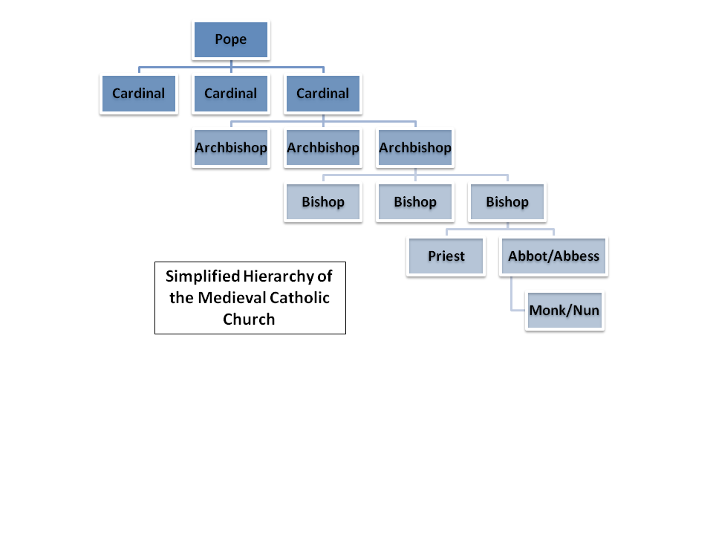
Church Hierarchy
The church acted as a powerful force in unifying Europe despite differences in culture, language and customs.
Monasteries acted as centers of school, refuge, libraries, and duplicating (books).

Slide 10
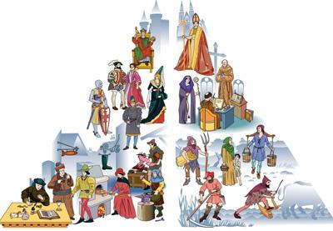
High Middle Ages
1000-1500 C.E.
Signs of civilizations recovery, accelerated by 1200 C.E.
Hierarchy becomes more complex as middle class emerges.
Resurgence of arts, artisan/craftsmen class, trade technological innovations -plows, horse collalrs, agricultural methods.
More Food = Population Increase, toens grow into cities.

Slide 11
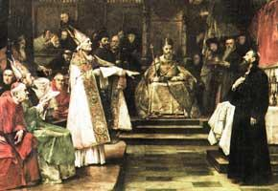
The Power of the Church
Canon Law- Church rules for behavior, filled the void of strong political authority.
Excommunication- The ability of the church to ban individuals from sacrament.
Interdict- Excommunicated all people in the realm of a kingdom.

Slide 12
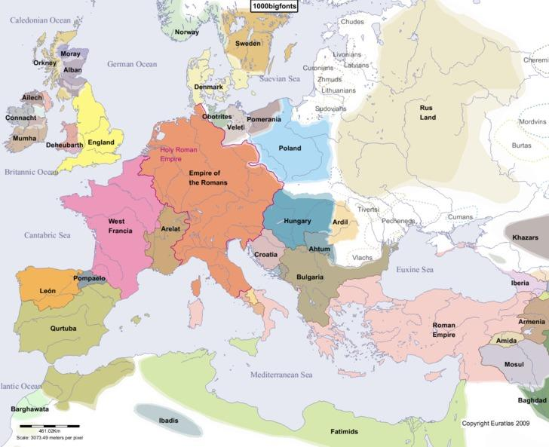
Western Europe Grows Centralized Governments
England, France and Spain remain strong and stable up through 1450 CE.
Early signs of political progress:
  Limited Government
  Magna Cart (forced signature of King John)
  Parliaments
  Fostered growth for Democracies.

Slide 13
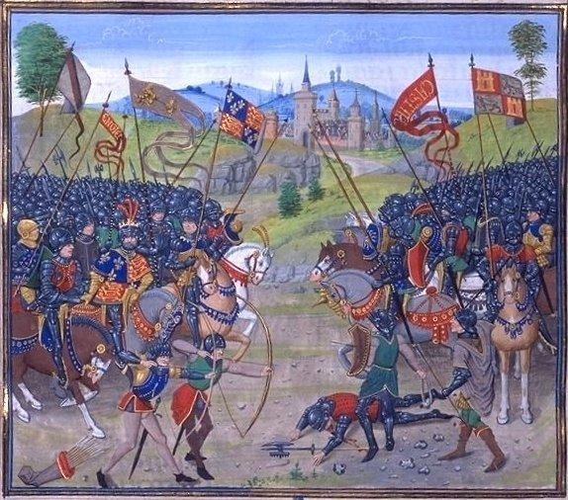
100 Years War
William The Conqueror of Normandy, takes England at Battle of Hastings
During 14th and 15th centuries, Frances kingdoms fight England over English territories. Clash between old governing rules under feudalism and modern claims of nation states.

Slide 14
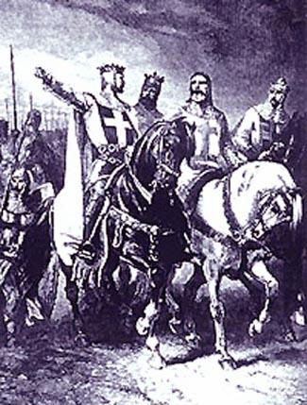
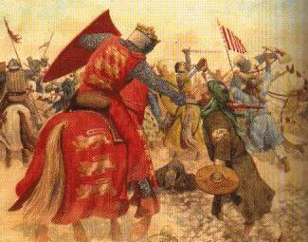
Crusades
Call for Purification of Christianity.
Christian Zeal of Missionaries who feel obligated to spread as populations push Christianity to new borders.
Pope Urban II in 1095 C.E. calls upon christians to save the holy city of Jerusalem, from the Turks, by undertaking a journey “for the remission of your sins, and be assured of the reward of imperishable glory in the Kingdom of Heaven.”

Slide 15
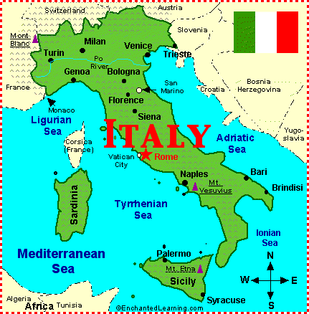
Economic Developments
Venice and Genoa Italy remained unwilling to abandon roots of Roman Empire, they never adopted Feudalism.
Both cities rivaled Constantinople of The Roman Empire by the early 13th century.
Banking in the West - use of money and investments.
Complex Trade from North to South exchanging Timber and Grain in the North for Metals and Cloth in the South > Specialization

Slide 16
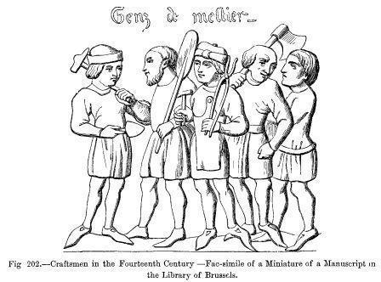
Hanseatic League
Facilitated trade as more towns purchase charters, severing feudal ties.
Towns emerge and produce more wealth for the king, who in turn builds larger more powerful armies.
Craftsmen from Guilds for specialized labor. Sharing ideas, training apprentices.

Slide 17
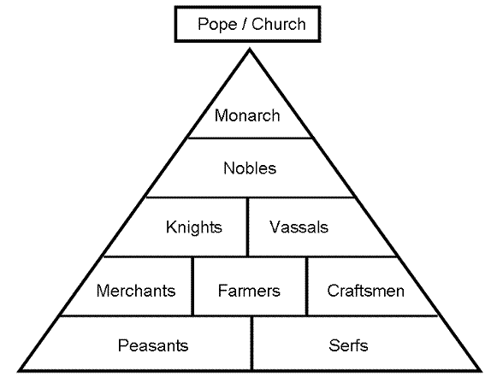
Mobility
Serfs begin to transform into skilled labor workers, traders and merchants.
Churches hold large estates of land and maintain wealth, act as lenders to prospective traders and merchants.
Banking industry dominated by Jews, who were forbidden from craft guilds and land ownership.
  Eventually Jews were driven out of Western Europe to Eastern Europe by Mobs.

Slide 18
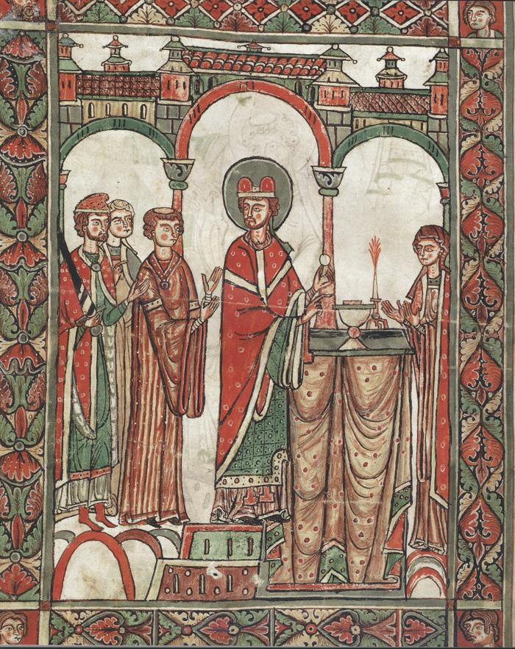
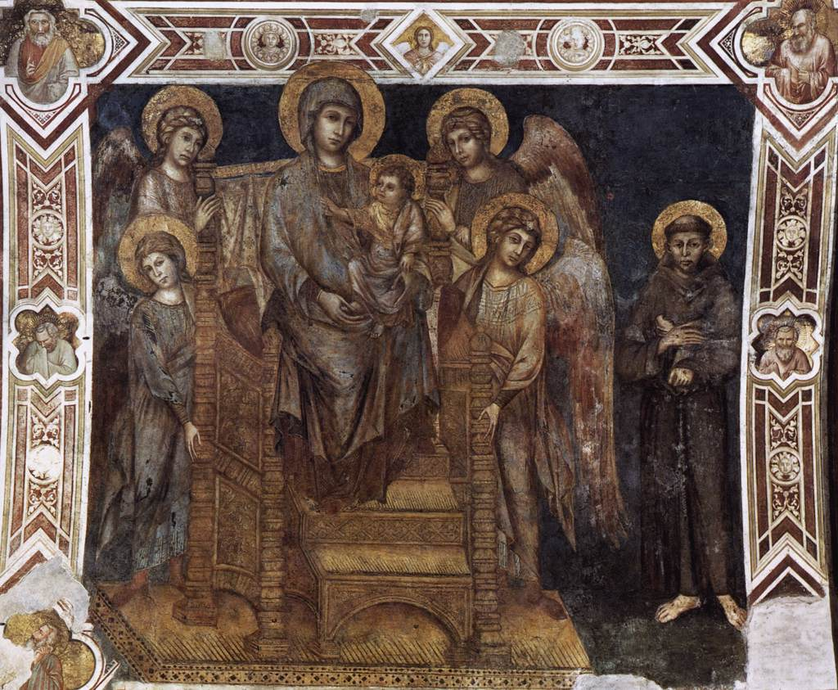
Culture and Art
Italy serves as a pre-renaissance hub of culture, education and trade.
Art becomes more realistic and stylistic, breaking from trends that were established centuries prior.
Universities emerge outside of Italy in France, Germany and England. By 1200, universities begin teaching Greek and Roman Works, not just religion.
Scholasticism- reconcile beliefs of religion with Greek Logic/philosophy.

Slide 19
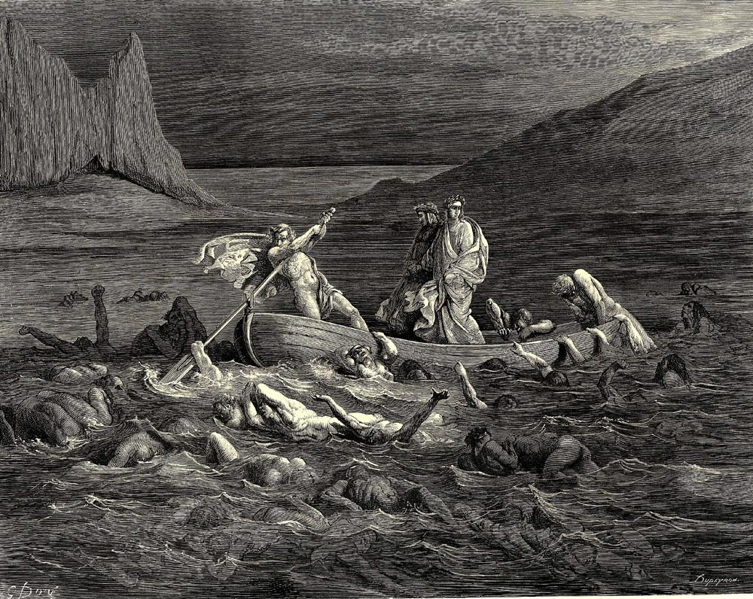
1300’s
Art, language and culture develop rapidly, starting in Italy.
Vernacular Languages, not just Latin are being published and translated.
Common Oral Languages (Vernacular) are replacing old Latin in print, started with The Divine Comedy, which outlined the 3 parts of the afterlife: Inferno, Purgatorio and Paradiso.

